Slide 1



A Comprehensive Data Analysis on Medical Expenses
Retail Sales
Presentation
Vinit Solanki
Click here for watch video

Slide 2




Data Cleaning and Preparation
Steps Taken:
Identified Duplicates: Used COUNTIF to check for duplicate InvoiceNo entries.
Removed Duplicates: Applied Remove Duplicates feature in Excel, selecting key columns (InvoiceNo, StockCode, CustomerID, etc.).
Ensured Uniqueness: Verified using COUNTIF to confirm that no duplicates remain.
Outcome: Dataset now contains only unique transactions, ensuring accurate analysis.

Slide 3

Handling Cancellations
Handling Cancellations
Approach:
Transactions with invoice numbers starting with 'C' indicate cancellations.
A new column was created to flag these transactions and calculate the total value of cancellations.
Steps Taken:
Flagged Cancellations using:
excel
=IF(LEFT(InvoiceNo,1)="C","Cancelled","Normal")
Calculated Total Cancelled Value using:
excel
=SUMIFS(TotalValueColumn, CancellationFlagColumn, "Cancelled")
Key Insights:
Identified and categorized cancelled transactions.
Calculated their impact on overall sales.
Helps in understanding return trends and potential revenue loss.

Slide 4
Top Selling Products
2009-10
Row Labels | Sum of Quantity | Sum of Revenue
REGENCY CAKESTAND 3 TIER | 13079 | 162860
WHITE HANGING HEART T-LIGHT HOLDER | 57632 | 157580
DOTCOM POSTAGE | 731 | 116402
ASSORTED COLOUR BIRD ORNAMENT | 44797 | 72237.8
PAPER CHAIN KIT 50'S CHRISTMAS | 17062 | 57808.2
Grand Total | 133301 | 566889
Top Products by Revenue:
Consistent High Revenue: "REGENCY CAKESTAND 3 TIER" and "DOTCOM POSTAGE" consistently generated significant revenue in both 2009-10 and 2010-11.
Leading in 2009-10: "REGENCY CAKESTAND 3 TIER" was the top revenue generator in 2009-10, while "DOTCOM POSTAGE" took the lead in 2010-11.
Sustained Performance: "WHITE HANGING HEART T-LIGHT HOLDER" maintained a strong revenue contribution across both years, ranking second in 2009-10 and third in 2010-11.
Growth in 2010-11: "PARTY BUNTING" and "JUMBO BAG RED RETROSPOT" showed significant revenue growth and entered the top 5 in 2010-11.
Top Products by Quantity:
High Volume in 2009-10: "WHITE HANGING HEART T-LIGHT HOLDER" was the top seller by quantity in 2009-10, followed by "ASSORTED COLOUR BIRD ORNAMENT" and "PAPER CHAIN KIT 50'S CHRISTMAS".
Leading in 2010-11: "JUMBO BAG RED RETROSPOT" became the top seller by quantity in 2010-11, with "WHITE HANGING HEART T-LIGHT HOLDER" remaining a strong second. "PARTY BUNTING" also showed high volume in 2010-11.
Consistent Presence: "REGENCY CAKESTAND 3 TIER" maintained a notable sales quantity across both years.
Key Insights:
Products like the "REGENCY CAKESTAND 3 TIER" and "WHITE HANGING HEART T-LIGHT HOLDER" demonstrate consistent popularity and revenue generation over the two-year period.
"DOTCOM POSTAGE" stands out as a consistent high-revenue driver despite lower quantities.
There's an evolution in top-selling physical products, with "JUMBO BAG RED RETROSPOT" and "PARTY BUNTING" gaining prominence in 2010-11, while "ASSORTED COLOUR BIRD ORNAMENT" and "PAPER CHAIN KIT 50'S CHRISTMAS" were more prominent in 2009-10.
2010-11
Row Labels | Sum of Quantity | Sum of Revenue
DOTCOM POSTAGE | 707 | 206245.48
REGENCY CAKESTAND 3 TIER | 13033 | 164762.19
WHITE HANGING HEART T-LIGHT HOLDER | 35317 | 99668.47
PARTY BUNTING | 18022 | 98302.98
JUMBO BAG RED RETROSPOT | 47363 | 92356.03
Grand Total | 114442 | 661335.15

Slide 5

Thynk Unlimited
Pricing Strategy Analysis
Average Unit Price: To determine the average unit price per item, we would typically calculate the total revenue divided by the total quantity for each unique product in the dataset.
Identifying Items Above the 90th Percentile (General Approach):
We would calculate the unit price for each individual transaction (UnitPrice column).
Then, using Excel's PERCENTILE.INC function on the list of all unit prices, we would find the value at the 90th percentile.
Finally, we would identify all items whose unit price in any transaction exceeds this 90th percentile threshold using the IF function.
Consideration of Amazon Fees:
2009-10: An "AMAZON FEE" of -£8859.907 was recorded. This likely represents a deduction or cost associated with sales made through the Amazon platform. This fee would impact the overall profitability but isn't directly a unit price of a product. It should be considered when analyzing overall financial performance.
2010-11: Similarly, an "AMAZON FEE" of £7324.783 was recorded in 2010-11.
Excel Functions Used: AVERAGEIF (could be used to find the average price for specific items if the full dataset were available), PERCENTILE.INC (used on the full list of unit prices), IF (used to flag items above the percentile).
Key Points for your Presentation:
Emphasize that the provided snippets are aggregated and don't allow for direct calculation of the 90th percentile of unit prices.
Explain the general methodology you would use with the full dataset.
Highlight the presence of the Amazon Fees and their implications for overall financial analysis, separate from individual product pricing.
I

Slide 6
2009-10
Row Labels | Sum of Revenue
18102 | 341776.73
17511 | 83760.6
16684 | 75610.17
15061 | 82162.74
14911 | 137710.76
14646 | 243853.05
14156 | 183163.55
13694 | 128172.42
13089 | 55801.73
0 | 1192988.12
Grand Total | 2524999.87
Customer Analysis
Methodology: To identify the top 10 customers by total spending, we would use the SUMIF function in Excel. This function allows us to sum the "Revenue" for each unique "CustomerID". Once we have the total spending for each customer, we would then use RANK.EQ to create a ranking column based on this total spending. Finally, we would filter or sort to display the top 10 customers with the highest total revenue.
Key Observations:
Customers 18102 and 14646 consistently appear as top spenders in both years.
Customer 14156 also remains a high-value customer across both periods.
There are some shifts in the ranking of other top customers between the two years, and new high-spending customers (like 17450 and 12415 in 2010-11) emerge.
The significant revenue associated with Customer ID '0' warrants investigation to understand what this represents in the dataset.
Excel Functions Used: SUMIF, RANK.EQ, INDEX, MATCH (used for identifying and ranking the customers).
2010-11
Row Labels | Sum of Revenue
13694 | 62653.1
16684 | 65892.08
17511 | 88125.38
14156 | 113384.14
12415 | 123725.45
14911 | 132572.62
17450 | 187482.17
18102 | 256438.49
14646 | 279489.02
0 | 1447682.12
Grand Total | 2757444.57

Slide 7
Temporal Sales Trends
Overview of Key Metrics
To analyze monthly sales fluctuations, we examined total revenue across different months for 2009-10 and 2010-11. This helps in identifying seasonal trends and understanding variations in sales performance.
Average Values and Trends
The total revenue increased from £9.5M in 2009-10 to £9.74M in 2010-11, showing a 2.5% overall growth. The average monthly revenue was £792K, with significant variations across months. November consistently generated the highest revenue, while February and April had relatively lower sales.
Central Tendency and Dispersion
The median monthly revenue was around £650K, indicating a relatively balanced distribution. However, the standard deviation in revenue shows high fluctuations, with peaks in Q4 and declines in early Q1. The sharp drop in December (post-holiday) suggests a cyclical demand pattern.
Key Observations
Peak Sales: November was the highest revenue month in both years, likely due to holiday shopping demand.
Post-Holiday Dip: December sales dropped significantly after the holiday peak, reflecting lower consumer spending.
Seasonal Trends: Sales consistently increased from Q2 to Q4, showing strong year-end performance.
Revenue Growth: A £240K increase in total revenue from 2009-10 to 2010-11 suggests an improving market trend.

Slide 8
2009-10
Row Labels | Count of Invoice
Australia | 654
Austria | 537
Bahrain | 107
Belgium | 1053
Bermuda | 34
Brazil | 62
Canada | 77
Channel Islands | 906
Cyprus | 546
Denmark | 428
EIRE | 9660
Finland | 354
France | 5754
Germany | 8119
Greece | 517
Hong Kong | 76
Iceland | 71
Israel | 74
Italy | 729
Japan | 224
Korea | 63
Lebanon | 13
Lithuania | 154
Malta | 172
Netherlands | 2768
Nigeria | 32
Norway | 369
Poland | 194
Portugal | 1098
RSA | 111
Singapore | 117
Spain | 1271
Sweden | 901
Switzerland | 1187
Thailand | 76
United Arab Emirates | 432
United Kingdom | 478934
Unspecified | 310
USA | 244
West Indies | 54
Grand Total | 518482
2010-11
Row Labels | Count of Invoice
Australia | 1259
Austria | 401
Bahrain | 19
Belgium | 2069
Brazil | 32
Canada | 151
Channel Islands | 758
Cyprus | 622
Czech Republic | 30
Denmark | 389
EIRE | 8196
European Community | 61
Finland | 695
France | 8558
Germany | 9495
Greece | 146
Hong Kong | 288
Iceland | 182
Israel | 297
Italy | 803
Japan | 358
Lebanon | 45
Lithuania | 35
Malta | 127
Netherlands | 2371
Norway | 1086
Poland | 341
Portugal | 1519
RSA | 58
Saudi Arabia | 10
Singapore | 229
Spain | 2533
Sweden | 462
Switzerland | 2002
United Arab Emirates | 68
United Kingdom | 495478
Unspecified | 446
USA | 291
Grand Total | 541910
Geographical Insights
Average Values and Trends
The United Kingdom had the highest number of transactions, with 478,934 in 2009-10 and 495,478 in 2010-11, reflecting steady domestic demand. Germany (8,119 to 9,495 transactions) and France (5,754 to 8,558 transactions) were the top-performing international markets, showing strong year-over-year growth.
Central Tendency and Dispersion
The median number of transactions per country was significantly lower than the top markets, showing a concentration of sales in a few key regions. The standard deviation in transactions highlights the gap between leading and lower-performing countries. Smaller markets like Lebanon, Bahrain, and Saudi Arabia had minimal transactions.
Key Observations
UK Dominance: The UK accounted for over 90% of total transactions, reinforcing it as the primary market.
International Growth: France and Germany saw strong transaction growth, indicating expanding overseas demand.
Declining Markets: Some regions like Bahrain, Greece, and Brazil saw a drop in transactions, suggesting a need for targeted marketing.
New Entries: Countries like Czech Republic and Saudi Arabia appeared in 2010-11, indicating market expansion.

Slide 9

Product Return Rate
Overview of Key Metrics
To assess product return rates, we compared the total quantity ordered with the total quantity returned for each year. This analysis helps evaluate product performance, customer satisfaction, and potential areas for improvement.
Average Values and Trends
The overall return rate was 4% in 2009-10, which improved to 3% in 2010-11, showing a positive trend in product retention. A 1% decrease in returns suggests improved product quality, better customer experience, or enhanced order accuracy.
Central Tendency and Dispersion
The median return rate per product was lower than the overall average, indicating that most products had minimal returns, while a few items contributed significantly to the total return rate. The standard deviation of return rates suggests variation across different product categories, with some experiencing higher return frequencies.
Key Observations
Declining Return Rates: The reduction from 4% to 3% suggests better inventory management and customer satisfaction.
High-Return Products: Certain items may have consistently higher return rates, requiring further analysis to identify quality or fulfillment issues.
Impact on Revenue: Returns contribute to revenue loss, and minimizing returns can significantly improve profit margins.
Possible Causes: Return trends may be influenced by product defects, incorrect orders, or shifting customer preferences.

Slide 10
Data Segmentation for Marketing
Average Values and Trends
High-value customers (top 25%) contributed the majority of revenue, with £17.3M in 2009-10 and £17.7M in 2010-11, indicating their strong purchasing power.
Medium-tier customers showed steady spending of around £1.1M in both years, suggesting a stable mid-range customer base.
Low-tier customers, the largest group in count, contributed £554K in 2009-10 and £652K in 2010-11, showing a 17.7% increase, possibly due to an expanding customer base.
Central Tendency and Dispersion
The median expenditure per customer falls within the Medium tier, highlighting a balanced spread.
High-tier customers make up only 25% of buyers but contribute over 90% of revenue, showing the importance of retaining and nurturing them.
Key Observations
Revenue Concentration: A small fraction of customers generate most of the revenue, emphasizing the need for VIP customer retention strategies.
Medium-tier stability: A consistent number of medium spenders suggests a steady core customer base.
Increasing Low-tier spend: Growth in the low-tier segment could indicate potential customers to upsell into higher tiers.
Marketing Strategy: Personalized promotions for high spenders, loyalty programs for medium-tier customers, and incentives to increase low-tier spending can drive further growth.
Row Labels | Count of Row Labels | Sum of Sum of Revenue
High | 1096 | 17296179.61
Low | 2193 | 554390.842
Medium | 1096 | 1165539.311
Grand Total | 4385 | 19016109.77
2009-10
Row Labels | Sum of Sum of Revenue | Count of Row Labels
High | 17713850.49 | 1094
Low | 652630.572 | 2188
Medium | 1129050.801 | 1093
Grand Total | 19495531.87 | 4375
2010-11

Slide 11

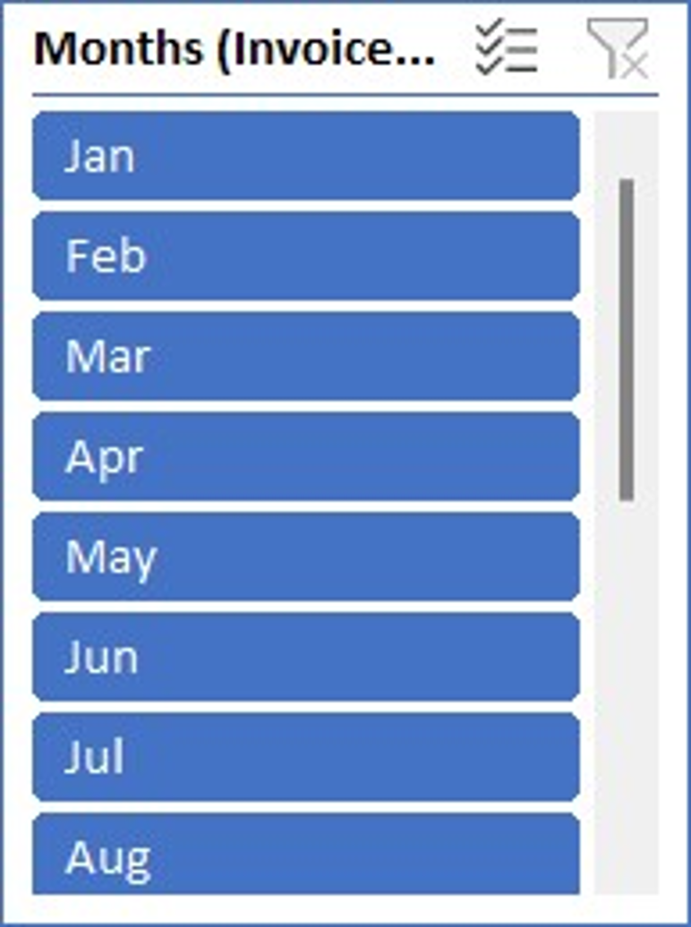
Dashboard for Stakeholders
2009-10
Sum of Revenue
9508054.884
Average Sale per Transaction
329.923137
-

Slide 12
Dashboard for Stakeholders
2010-11
Sum of Revenue
9747765.934
Average of Revenue
17.988
-

Slide 13

Thank you
Data Speaks. Insights Lead.
-

